Slide 1
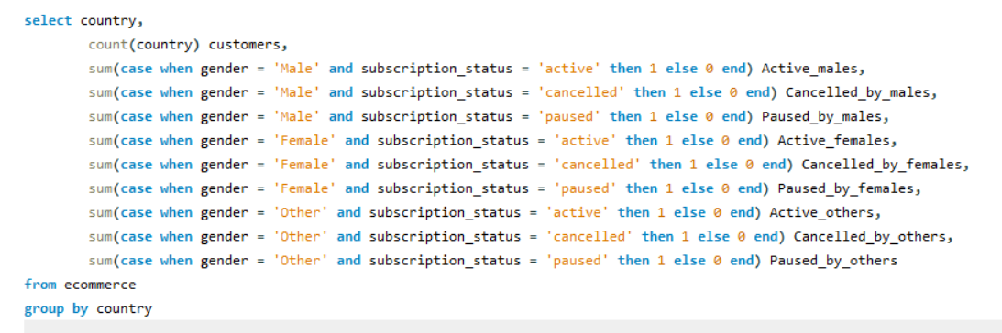
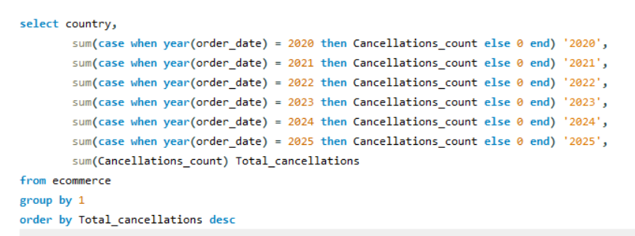

Ecommerce Data Analysis With MySQL

Slide 2
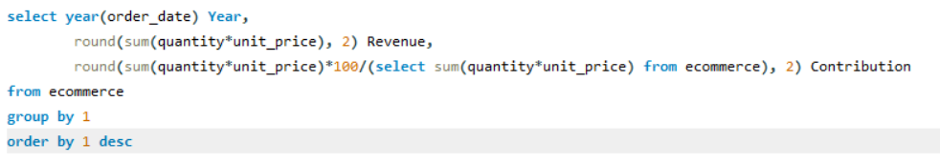
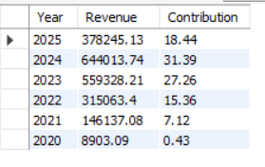
Year wise Growth

Slide 3
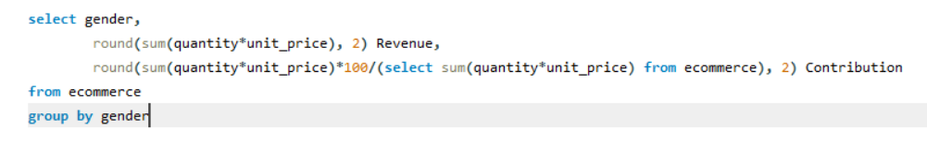

Gender wise Contribution

Slide 4
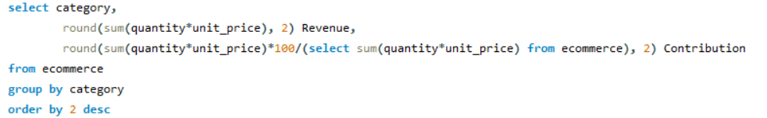
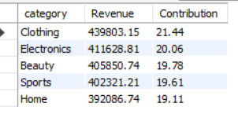
Category wise Contribution

Slide 5
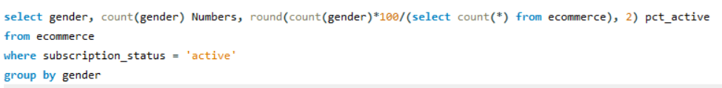
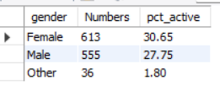
Gender Wise Active Numbers

Slide 6
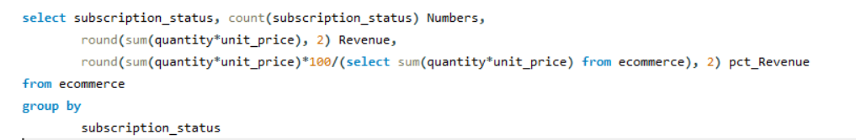
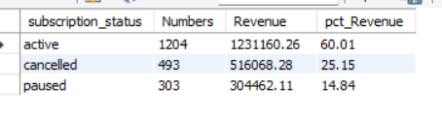
Revenue by Subscription Status

Slide 7
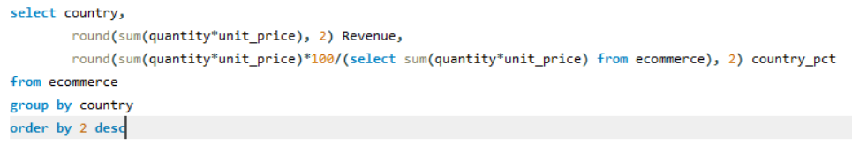
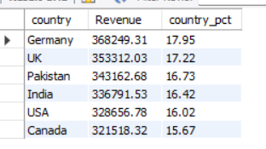
Country Wise Revenue

Slide 8
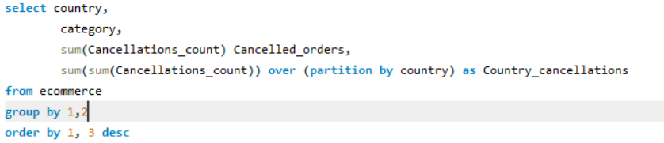
Most Cancellations by Category in Each Country
country | category | Cancelled_orders | Country_cancellations
Canada | Electronics | 181 | 797
Canada | Beauty | 173 | 797
Canada | Sports | 155 | 797
Canada | Clothing | 149 | 797
Canada | Home | 139 | 797
Germany | Clothing | 225 | 886
Germany | Electronics | 191 | 886
Germany | Sports | 182 | 886
Germany | Beauty | 153 | 886
Germany | Home | 135 | 886
India | Clothing | 188 | 776
India | Electronics | 170 | 776
India | Home | 166 | 776
India | Beauty | 127 | 776
India | Sports | 125 | 776
Pakistan | Clothing | 187 | 819
Pakistan | Beauty | 172 | 819
Pakistan | Home | 160 | 819
Pakistan | Sports | 156 | 819
Pakistan | Electronics | 144 | 819
UK | Electronics | 211 | 856
UK | Sports | 194 | 856
UK | Home | 170 | 856
UK | Beauty | 145 | 856
UK | Clothing | 136 | 856
USA | Clothing | 173 | 749
USA | Electronics | 162 | 749
USA | Home | 156 | 749
USA | Sports | 134 | 749
USA | Beauty | 124 | 749

Slide 9
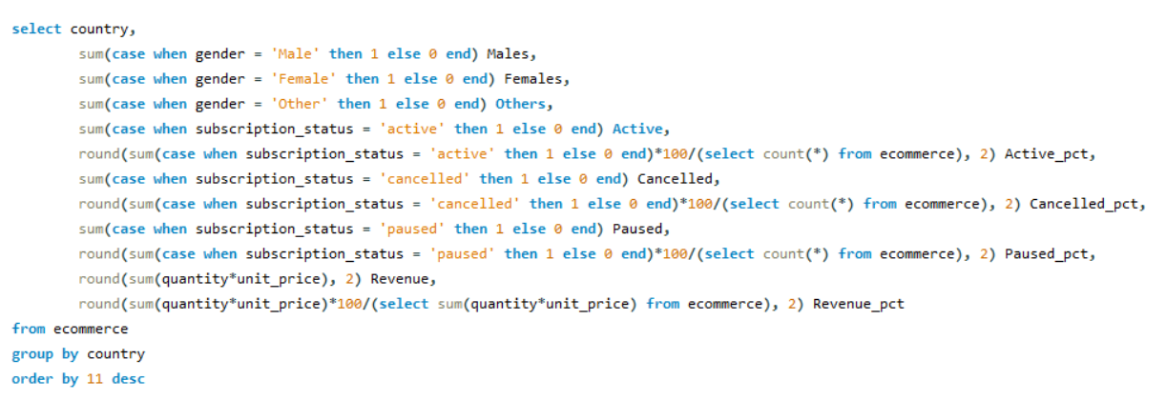
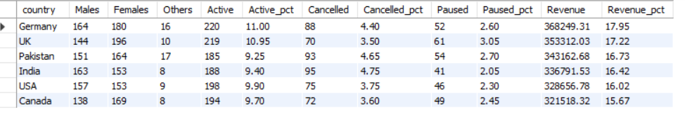
Subscription Status in Each Country

Slide 10
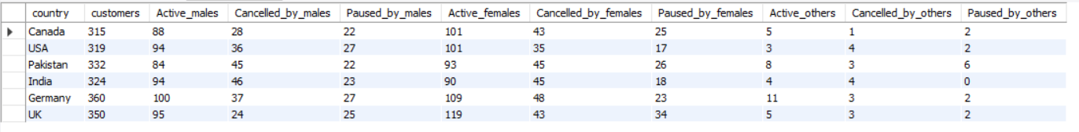
Gender Wise Subscription Status in Each Country

Slide 11
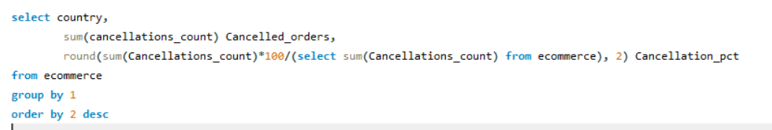
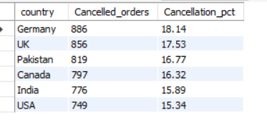
Country Wise Order Cancellations

Slide 12
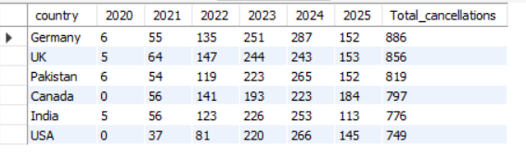
Year Wise Order Cancellations in Each Country

Slide 13
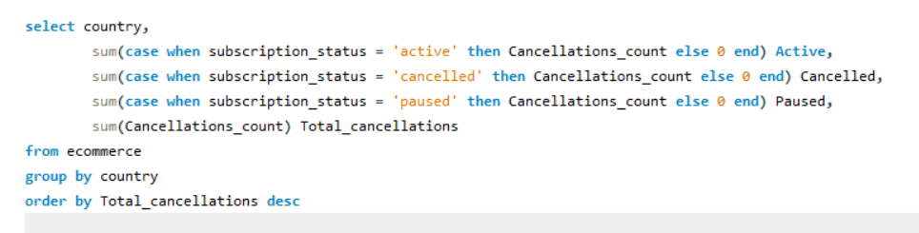
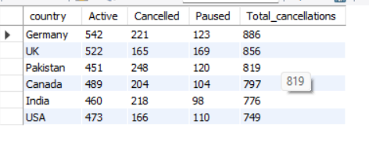
Order Cancellation by Subscription Status in Each Country

Slide 14
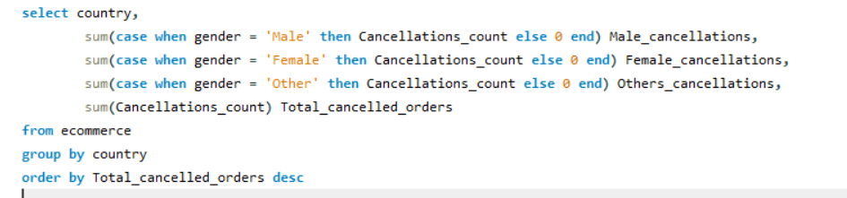
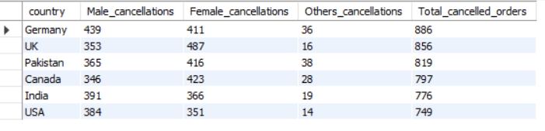
Gender Wise Order Cancellations in Each Country

Slide 15
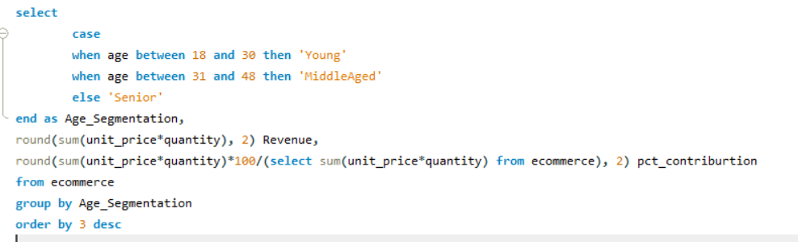
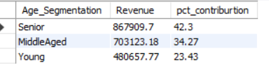
Age Segmentation

Slide 16
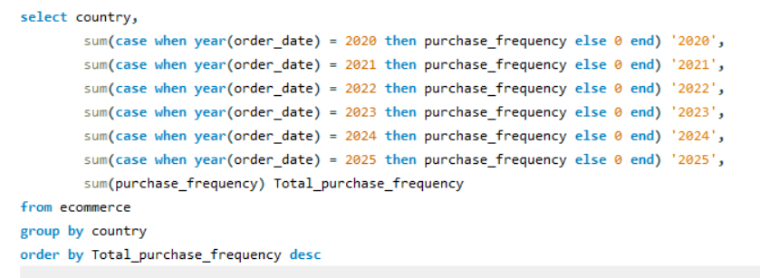
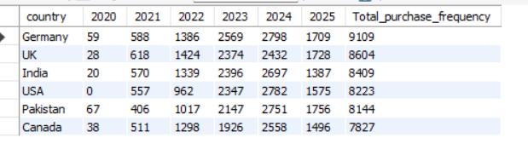
Year Wise Purchase Frequency in Each Country

